Slide 1
Employee Data Analysis using Excel
STUDENT NAME: sheran D
REGISTER NO:122204049
DEPARTMENT: b.com (corporate secretaryship)
COLLEGE: shiri Krishanaswamy college for women

Slide 2
PROJECT TITLE
Employee Performance Analysis using Excel

Slide 3


AGENDA
Problem Statement
Project Overview
End Users
Our Solution and Proposition
Dataset Description
Modelling Approach
Results and Discussion
Conclusion
3/21/2024 Annual Review

Slide 4

PROBLEM STATEMENT
Despite increased awareness of diversity and inclusion, there remains a gender disparity in the technology sector, with men often outnumbering women in technical roles. This imbalance may be influenced by factors such as recruitment practices, workplace culture, career progression opportunities, and the distribution of leadership roles. Understanding the current gender composition across different levels of responsibility and types of roles is critical to addressing potential biases and barriers faced by underrepresented genders. This study seeks to analyze the gender distribution within the technology workforce, identify gaps in representation, and recommend strategies to improve gender diversity and equity in hiring, retention, and leadership roles within the technology sector

Slide 5

PROJECT OVERVIEW
Project Overview: Technology Employee Gender Analysis
Objective: The primary goal of this project is to assess the gender distribution and related dynamics within the technology workforce. By identifying patterns of representation, career progression, pay disparity, and leadership roles based on gender, the project aims to uncover barriers that may contribute to gender inequality in the tech industry.
Key Areas of Focus:
Gender Distribution by Role and Department:
Analyze the proportion of male, female, and non-binary employees in various tech roles such as software development, engineering, data science, IT support, and managerial positions.
Career Progression and Leadership:
Investigate the presence of gender disparities in promotion rates, leadership roles, and decision-making positions (e.g., team leads, managers, directors, and C-suite executives).
.

Slide 6

WHO ARE THE END USERS?
HR Departments and Talent Acquisition Teams
They use gender analysis to improve recruitment practices, ensure diversity in hiring, and promote inclusivity in the workplace.
C-Level Executives and Senior Management
Decision-makers use these insights to implement strategic diversity initiatives, close gender gaps, and ensure company policies align with equitable practices.
Diversity and Inclusion Teams
These teams focus on creating programs and initiatives that support gender diversity and inclusion in the workplace.
Policy Makers and Industry Regulators
Government agencies and industry groups might use this data to inform policies or legislation aimed at reducing gender disparity in the tech industry.
Employees and Advocacy Groups
Employees and internal advocacy groups may use gender analysis to raise awareness, push for gender equality, and ensure a fair working environment.

Slide 7
OUR SOLUTION AND ITS VALUE PROPOSITION
A Gender Diversity Analytics Platform that leverages advanced analytics, data visualization, and AI to provide actionable insights into gender representation, pay gaps, promotion rates, and career progression within tech companies.
Key Features:
Comprehensive Data Dashboard
Real-time data on gender distribution across departments, roles, and seniority levels.
Pay and Promotion Gap AnalysisIdentify and quantify discrepancies in pay and promotion rates between male, female, and non-binary employees.
Hiring and Retention AnalyticsAnalyze gender trends in recruitment, attrition, and retention to uncover biases or areas for improvement.

Slide 8
Dataset Description
HR Departments and Talent Acquisition Teams
They use gender analysis to improve recruitment practices, ensure diversity in hiring, and promote inclusivity in the workplace.
C-Level Executives and Senior Management
Decision-makers use these insights to implement strategic diversity initiatives, close gender gaps, and ensure company policies align with equitable practices.
Diversity and Inclusion Teams
These teams focus on creating programs and initiatives that support gender diversity and inclusion in the workplace.
Policy Makers and Industry Regulators
Government agencies and industry groups might use this data to inform policies or legislation aimed at reducing gender disparity in the tech industry.

Slide 9
THE "WOW" IN OUR SOLUTION
. AI-Powered Predictive Insights
Wow Factor: Leverage machine learning to predict future trends in gender diversity, such as where gender gaps may widen if no interventions are made. It can simulate the impact of different diversity initiatives (e.g., mentorship programs, pay equity adjustments) to help organizations understand the potential outcomes of their actions.
Value: This allows companies to be proactive rather than reactive, ensuring that they can make data-driven decisions before gender issues escalate.
Intersectional Analysis (Gender, Race, Age, etc.)
Wow Factor: The platform doesn’t just look at gender in isolation. It allows for an intersectional analysis, examining how gender interacts with race, age, and other demographic factors. This reveals deeper layers of bias and provides a more holistic view of diversity.
Value: It gives organizations a comprehensive understanding of their workforce, enabling more targeted and nuanced strategies for diversity and
3/21/2024 Annual Review
9

Slide 10
MODELLING
1. Descriptive Analytics (Summary Statistics)
Objective: Provide a detailed understanding of the current state of gender diversity within the organization.
Methods:
Gender Distribution: Calculate percentages of employees by gender across departments, roles, and seniority levels.
Pay Gap Analysis: Use summary statistics (mean, median) to compare compensation across genders.
2. Predictive Modeling
Objective: Forecast gender-related outcomes such as future diversity levels, employee turnover, and promotion likelihoods.
Methods:
Logistic Regression:
Use Case: Predict the probability of an employee being promoted based on their gender, tenure, performance, and other factors.
10

Slide 11
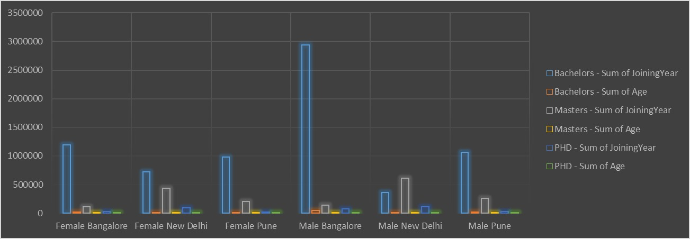
RESULTS
11

Slide 12
conclusion
Technology Employee Gender Analysis
A Technology Employee Gender Analysis provides organizations with a critical understanding of gender dynamics within their workforce. By leveraging advanced analytics, machine learning models, and data-driven insights, this analysis identifies gaps in representation, pay equity, promotion, retention, and overall inclusion. The following key takeaways emerge from such an analysis:
Data-Driven Decision Making: Gender analysis enables companies to move beyond anecdotal observations by providing quantifiable data on gender disparities. This leads to more informed decisions that drive meaningful change, such as reducing pay gaps, increasing female representation in leadership roles, and improving workplace culture for all genders.

